Slide 1

Text editor – Pattern matching

Slide 2
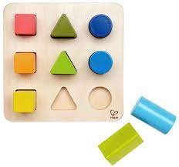
Content
Introduction
Pattern matching
Text editor
Boyer Moore Algorithm
Rabin Karp Algorithm

Slide 3

Introduction
AIM
To build a text editor using pattern
matching algorithm
To study and use the most efficient algorithm
To identify the given word accurately.
Term source: https://images.app.goo.gl/9hgVRdcGqv9XXXYA6

Slide 4
Timeline
Rabin Karp
Add functionality - find all and replace all
Boyer Moore’s
(find functionality)
Research
Week 1-3
Week 4,5
Week 6,7
Week 8
Week 9,10
Creating notepad text editor
Add functionality- replace

Slide 5
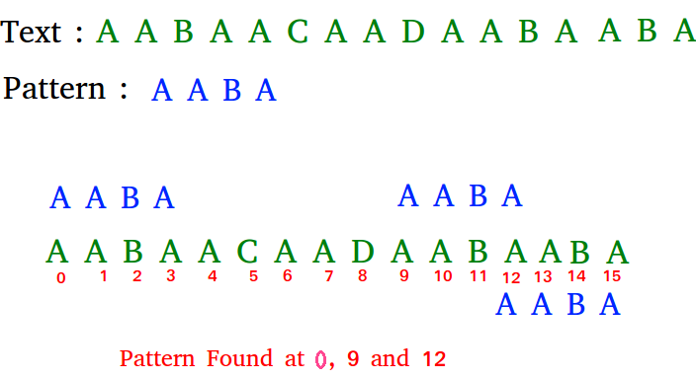
Pattern Matching
Also referred to as String Searching
The act of checking a given sequence of tokens for the presence of the constituents of some pattern.
Useful in the case of searching a string within another string.
Term source: https://www.geeksforgeeks.org/algorithms-gq/pattern-searching/

Slide 6
Implementation – Text editor
In the text editor, the user can write and edit text inside the next area which is nested inside a Jframe.
We create a menu bar which will consist of file, edit and view.
Features included:
File – new, open, save, print, exit
Edit – copy, paste, cut, select all, find text
View – light mode, dark mode

Slide 7
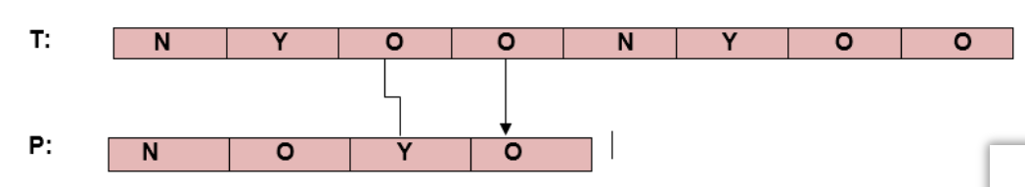
Implementation – Boyer Moore’s Algorithm
The B-M algorithm takes a 'backward' approach.
The pattern string (P) is aligned with the start of the text string (T).
Compares the characters of a pattern from right to left.
Pattern is changed entirely past the mismatching character.
B-M algorithm uses two preprocessing strategies
simultaneously.
B-M String search algorithm is a
particularly efficient algorithm

Slide 8
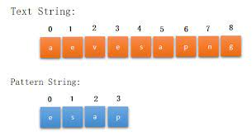
Implementation – Rabin Karp Algorithm
Due to the limitations of Boyer Moore’s we switched to the Rabin Karp algorithm.
It is used for searching/matching patterns in the text using a hash function.
A hash function is a tool to map a larger input value to a smaller output value. This output value is called the hash value.
It filters the characters that do not match and then perform the comparison.

Slide 9
Time Complexity
Algorithm | Pre-processing Time | Matching Time
Rabin-Karp | O(m) | (O (n - m + 1)m)
Boyer-Moore | O(|∑|) | (O ((n - m + 1) + |∑|))
Where,
n - length of the pattern
m -length of the text.

Slide 10
References
[1]. Weiner, P., 1973, October. Linear pattern matching algorithms. In 14th Annual Symposium on Switching and Automata Theory (swat 1973) (pp. 1-11). IEEE.
[2]. Tarhio, J. and Ukkonen, E., 1993. Approximate boyer–moore string matching. SIAM Journal on Computing, 22(2), pp.243-260.
[3]. Galil, Z., 1979. On improving the worst case running time of the Boyer-Moore string matching algorithm. Communications of the ACM, 22(9), pp.505-508.
[4]. Plaxton G. String Matching: Rabin-Karp Algorithm. Theory in Programming Practice. University of Austin, Texas. 2005.
[5]. Joshi, O.S., Upadhvay, B.R. and Supriya, M., 2017, August. Parallelized advanced rabin-karp algorithm for string matching. In 2017 International Conference on Computing, Communication, Control and Automation (ICCUBEA) (pp. 1-5). IEEE.

Slide 11


